Slide 1
Acoustic Eavesdropping through Wireless Vibrometry
Teng Wei, Shu Wang, Anfu Zhou
and Xinyu Zhang
University of Wisconsin – Madison
Chinese Academy of Sciences
Institute of Computing Technology
Chinese Academy of Sciences

Slide 2

Acoustic Eavesdropping through Wireless
Loudspeaker and Wi-Fi are widely used in the conference and home environment
Image wireless can pick up the sound and leak private information

Slide 3



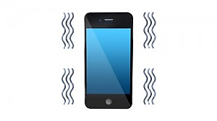



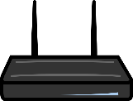

Threat Models
Reflective
Emissive
Victim
AP
Victim
Wall
Wall
Tx
Rx
Rx
Attacker
Attacker

Slide 4
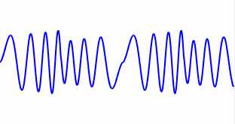


How Possible?
Acoustic-Radio Transformation (ART)
Translate acoustic vibration into radio signal fluctuation

Slide 5
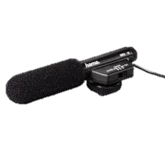
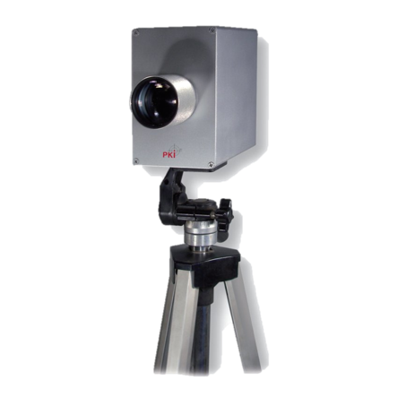
Pros and Cons: Technique Review
Directional
Microphones
Widely used in espionage and newsgathering
Fail in the sound-proof environment
Laser-based Microphone
Highly directional and sensitive
Require unobstructed line-of-sight between the subject and laser
Microwave-based
Microphone
Penetrate sound-proof material
and unblocked by obstacles

Slide 6
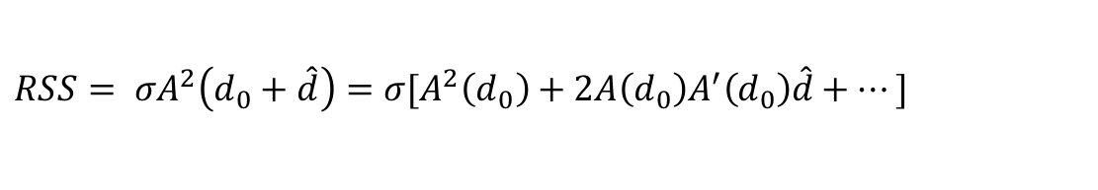
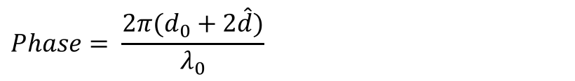
Understand Basic ART
Physical Model
DC component
High-order
harmonics
RSS-based ART
$$RSS= σA^{2}\left(d_{0}+\hat{d}\right)=σ[A^{2}\left(d_{0}\right)+2A\left(d_{0}\right)A^{′}\left(d_{0}\right)\hat{d}+…]$$
Audio signal
component
Radio pathloss
Taylor expansion
DC component
Phase-based ART
Audio signal
component
$$Phase= \frac{2π(d_{0}+2\hat{d})}{λ_{0}}$$
Micro Doppler
Audio Decoding of ART
Radio sampling frequency >> Audio sampling frequency
Modulate
a known
sequence
Frequency
domain
analysis
Estimate
Channel
RSS/Phase
Assemble
audio
signals
Passband
filter

Slide 7
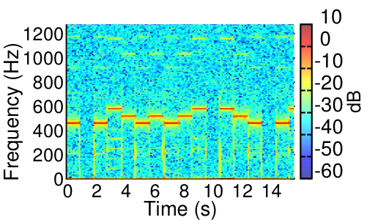

Validating Feasibility
Setup
Result
Piano sound 440Hz, 493.88Hz, 554.37Hz
2m
High-order
harmonics
Tx
0.5m
Rx
CW 5MHz
Channel 14
2.485GHz
Diversity

Slide 8
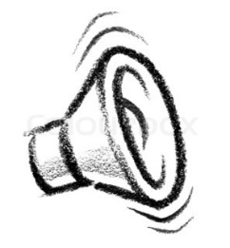
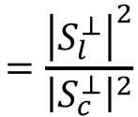
Influence of Multipath
Wireless signal is broadcasting in natural
Background
Reflection Path
Loudspeaker
Reflection Path
Tx
Rx
Multipath
affects
eavesdropping
quality
Received signal
Loudspeaker
reflection
Background
reflection
S
Q
S
Q
S_{c}
S_{c}
S_{l}
S_{l}
I
I
Good multipath profile
$$=\frac{{\left|S_{l}^{⊥}\right|}^{2}}{{\left|S_{c}^{⊥}\right|}^{2}}$$
>
Quality
Quality’

Slide 9


Enhanced 1: Spatial Diversity
Basic Idea
Antenna 1
Antenna 2
Beamform
S
Q
Q
Improved eavesdropping quality
Q
S_{c}
$$×w_{1}+$$
$$×w_{2}=$$
S_{l}
S_{l}
S_{l}
I
S
I
S
I
S_{c}
S_{c}
Weight Searching
Problem: no channel training
Solution: blind beamforming algorithm
Role-switching
Beamform
Problem: how to find Tx beamforming weights?
Rx weight
search 1
Role-switch
Rx weight
search 2
Rx
Tx
Tx
Rx
Rx
Tx
Radio 1
Radio 2
Radio 1
Radio 2
Radio 1
Radio 2

Slide 10
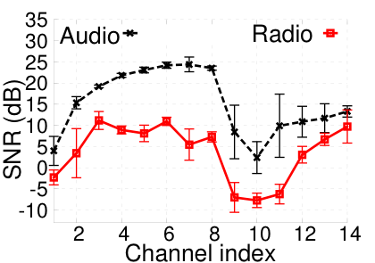
Enhanced 2: Frequency Diversity
Basic Idea
Alter angles of multipath profile
Channel 1
Channel 7
S
Q
S
Q
S_{c}
S_{l}
S_{l}
S_{c}
I
I
Avoid interference
Validation
Diversity
gain
Interference

Slide 11
Enhanced Emissive ART
AP
Attacker Rx
Audio Recovery (WiFi decoding)
STF
LTF
Header
Payload
①
②
③
Packet detection
CSI
estimation
Audio
assembling
Problem 1: Non-uniform packet arrival
Problem 2: Inaccurate signal amplitude estimation
LTF
Payload
time
2 OFDM symbols
100+ OFDM symbols
Solution: audio sample re-interpolation
Solution: RSS estimation and amplification

Slide 12

Counter Measure: Reflective ART
Safety Distance
Free space
model
2.4 GHz
12dB antenna gain
Drywall
Typical WiFi
Hardware
Interfering Mechanical Vibrations
Human
movement
Rotating
fan
…

Slide 13
Counter Measure: Emissive ART
Transmission Power Randomization
Original power of packets
Power
Uplink WiFi packets
time
Randomized power of packets
Power
time

Slide 14
Implementation and Testbed
Reflective ART decoder
802.11g/n-compliant
communication library
WARP FPGA
modification
WARP and WURC SDR testbed
Software Implementation
Testing Loudspeakers
Altec Lansing Multimedia Computer Speakers

Slide 15
Experiment Setup
Conference
Room
Diversity
gain
Distance to antenna: 1 ~ 5m
Sound-proof
Room

Slide 16
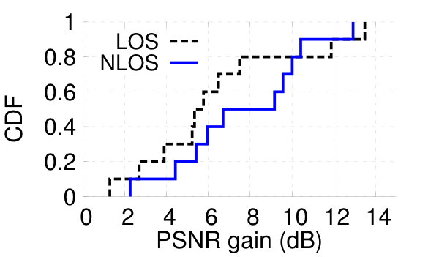
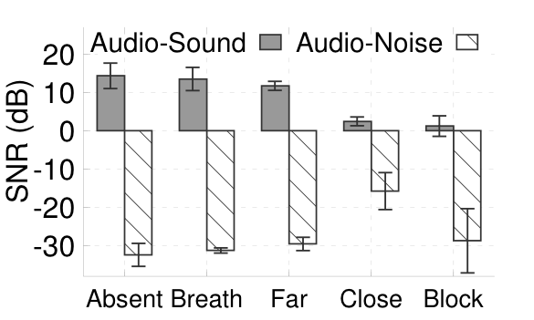
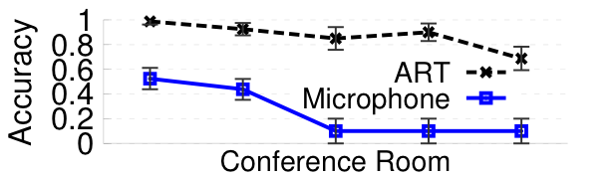
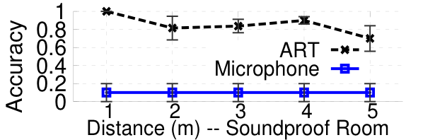

Reflective Eavesdropping
Beamforming
Human Impact
Environment
Penetrate wall and conventional sound isolator

Slide 17
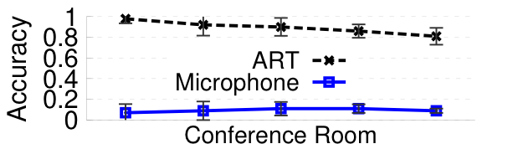
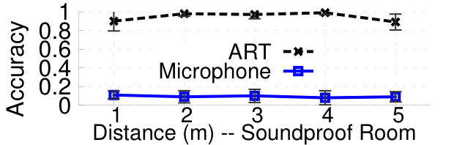

Emissive Eavesdropping
Experiment Setup
Victim: Moto X XT1053
AP: Belkin N150
Protocol: IEEE 802.11g
Running application: Iperf, TCP transferring at 10Mbps
Human Perception Accuracy
Good eavesdropping despite low sound volume

Slide 18
Effectiveness of Counter Measures
Validating Transmission Power Randomization (TPR)
Trace-driven simulation
Collect WiFi packet trace (1900pkt/s)
Enforce TPR on each of the collected packet
21dB
more than 2 orders of
magnitude reduction

Slide 19
Conclusion
First to thoroughly investigate vibrometry on wireless devices and practical attack models
Distill key factors that enable highly sensitive WiFi vibrometry
Basic ART
Enhanced reflective ART
Enhanced emissive ART
Extensive experiments using COTS smartphone, WiFi access point, and software-radio eavesdropper
Pose alarming challenges to securing acoustic in formation

Slide 20
Questions?
Thank you

